Slide 1


CARS
24
CRAFTING & COMPELLING WEBSITE ANALYSIS, AUDIT AND RECOMMENDATIONS

Slide 2


TASK-01
ABOUT THE
COMPANY
Cars24 is an online platform for buying and selling used cars. It simplifies the process by offering instant payments, hassle-free documentation, and a seamless experience for both buyers and sellers. Cars24 operates across India, revolutionizing the used vehicle marketplace

Slide 3




TASK-02
TOP
SERVICES
Facilitates seamless car auctions for dealers, improving inventory management
01
USED CAR SALES
03
BIKE24
02
CAR AUCTIONS FOR DEALERS
A separate platform for buying and selling used motorcycles
Platform to buy certified, pre-owned cars with warranties and easy financing

Slide 4
TASK 3 -
WEBSITE PLATFORM IDENTIFICATION
TOOLS USED: BUILTWITH
The CARS24 website is built on a sophisticated tech stack that emphasizes data science and AI-driven automation
They utilize proprietary in-house apps for car inspections, leveraging AI to ensure accurate quality checks
Their pricing models are entirely data-based, and the platform integrates end-to-end eCommerce capabilities similar to large-scale platforms like Amazon
I have analyzed these insights by using the website Builtwith

Slide 5
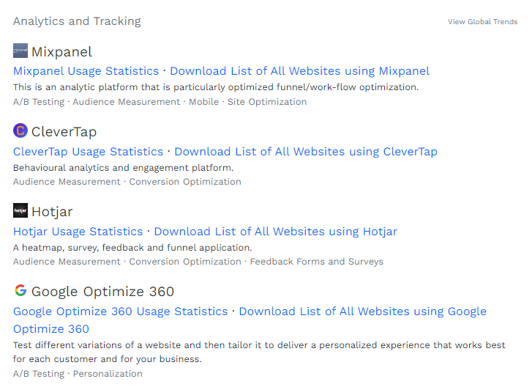
TASK 3 -
WEBSITE PLATFORM IDENTIFICATION

Slide 6
TASK 4 -
RESPONSIVE DESIGN TESTING
TOOLS USED: GTMETRIX
Reduce server response time
Optimize image sizes with width and height
Minimize DOM size for faster loading
Implement caching and use a CDN for static assets
Reduce unnecessary JavaScript and network payloads

Slide 7





TASK 5 -
WEBSITE MISTAKES IDENTIFICATION
Improve server response time to speed up page loading
Reduce excessive JavaScript for better performance
Minimize large network payloads by optimizing image sizes
Implement efficient caching for static assets to improve loading times
Simplify the payment and documentation process for smoother user transactions

Slide 8





TASK 6 -
WEBSITE BEST PRACTICES LIST
Improve Server Response Time
Reduce Excessive JavaScript
Minimize Large Network Payloads
Use a Content Delivery Network (CDN) and optimize server configurations for faster response times
Minimize unused JavaScript and defer non-critical scripts to improve page load times
Compress images and enable lazy loading to reduce network load and improve performance
Implement Efficient Caching
Simplify Payment and Documentation Processes
Set longer cache durations for static resources like images and scripts to avoid reloading them
Streamline the user interface by reducing steps and offering clear guidance for transactions and documentation

Slide 9
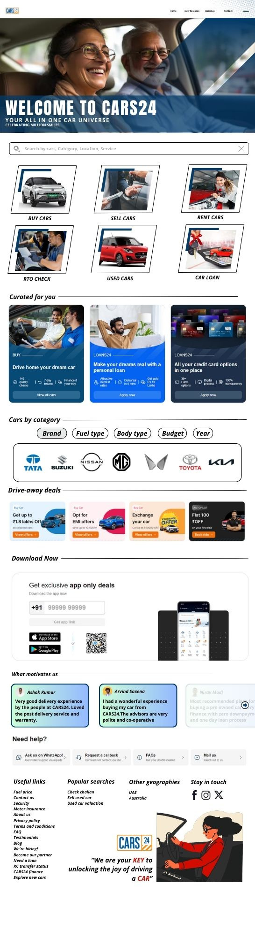
TASK 7-
LANDING PAGE DESIGN
TOOLS USED: CANVA
LINK :
LANDING PAGE DESIGN

Slide 10
CHANGES MADE
Added an elderly person image to create a welcoming, age-friendly first impression.
Highlighted Cars24’s key services prominently for customer convenience.
Introduced personalized suggestions for better customer experience.
Organized all categories under one section for easy navigation.
Featured hot deals to grab customer attention effectively.
Added Call-to-Action buttons and customer feedback to build trust.

Slide 11

SUBMITTED BY
MOHAMED AFSAR
BADM - MB26
MIAFSAR@GMAIL.COM
+91 9677476692
THANK
YOU

